Slide 1
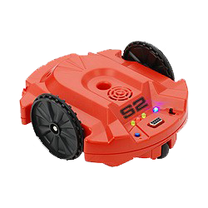
Scribbler Final Presentation
By Michael Borke

Slide 2
Outline
Scribbler Strengths and Weaknesses
Coolest things it can do
What I bring to the team (My “Secret Weapon”)
Summary

Slide 3
Strengths
For such a small robot, has A LOT of sensors
Immediate feedback
Extremely encouraging
No mechanical work necessary

Slide 4
Weaknesses
Can be tricky to connect for the first time
Fluke sensors are adjustable, Scribbler sensors are not
If they don’t work well, there isn’t much you can do about it

Slide 5
Coolest
Live-feed camera
Allows POV applications
So much potential, just does a lot of things
Limitless applications
Fluke2 adds even more capibility

Slide 6
Secret Weapon
Energetic
Creative
Fast Learner

Slide 7
SECRET WEAPON

Slide 8
Hardest/Wish List
Ability to download instructions to the Scribbler via the Fluke
Fluke2 has Micro USB port which may allow this
More accurate sensing, or at least easier to calibrate sensors
Learned that all robots are like this
No such thing as an “Easy Sensor”

Slide 9
Questions?

